Slide 1
CSE299 · SECTION 10 · TEAM NEXUS
Sprint 5 Weekly Project Review
Database Integration, Live API Wiring & CI/CD — Broken, Diagnosed, and Fixed
SPRINT SNAPSHOT Window: Aug 11 – 17, 2026 | Status: In Progress · 80% | Priority: High | Duration: 1 week
Jihanur Rahman Ratul (Jihan)
Tahsin Ahmed Sufol
Database, API Integration & CI/CD Fixes
Backend Review & Integration Support
Prepared for ITN Sir · CareerSetu — NSU Alumni-Industry Bridge Platform

Slide 2
PROJECT OVERVIEW
CareerSetu, at a Glance
Five sprints in, CareerSetu's FastAPI backend now sits on a real relational database — SQLAlchemy models seeded straight from NSU convocation CSVs and the employer directory, not static mock files.
SPRINT-BY-SPRINT STATUS
100%
Sprint 1
Completed
Jul 6 – 13
Data collection: NSU alumni & company datasets
That same push toward “real data everywhere” is what broke the CI/CD pipeline this week: the Docker Compose smoke test started failing the moment it tried to reach the ML microservice, which had no health endpoint yet.
100%
Sprint 2
Completed
Jul 13 – 21
Repository, branching strategy & CI/CD pipeline
This report covers Sprint 5 (Aug 11 – 17) — the database layer, the live-API wiring, the pipeline failure, and the fix that brought it back to green — and previews Sprint 6.
100%
Sprint 3
Completed
Jul 21 – Aug 3
10-page Next.js frontend, fully designed & built
100%
Sprint 4
Completed
Aug 4 – 10
Backend API, ML microservice & CI/CD integration
80%
Sprint 5
In Progress
Aug 11 – 17
Relational database layer, live API wiring & CI/CD fix
CareerSetu | Sprint 5 Weekly Review | CSE299 Sec.10
02 / 14

Slide 3
SPRINT 5 · AUG 11 – 17, 2026
Sprint Goal & Key Deliverables
SPRINT OBJECTIVE
Finalize CareerSetu by implementing a relational database layer (SQLAlchemy ORM, SQLite/PostgreSQL), auto-ingesting convocation datasets, connecting every frontend view to live FastAPI endpoints, and hardening CI/CD end to end.
SPRINT META
In Progress · 80%
High Priority
Database
Dev
QA
KEY DELIVERABLES
Duration
SQLAlchemy ORM layer with 7 database models (users, alumni, companies, jobs, applications, CV analysis, job-trust audit) across SQLite/PostgreSQL
1 week planned — pipeline debugging ran past the window
Automated CSV ingestion seeding convocation & company records straight into the database on startup
Owner
Jihanur Rahman Ratul (lead) — database, API integration & CI/CD fixes, reviewed with Tahsin Ahmed Sufol
A universal API client wiring every Next.js page (jobs, alumni, cv-grooming, employer, admin) to live FastAPI endpoints
Files Shipped
2 new DB modules, 2 new routers, new API client, 5 updated frontend pages, updated CI workflow & SPRINT5.md
CI/CD updated with 3 parallel jobs including Docker Compose smoke tests — which caught a real integration bug this sprint
CareerSetu | Sprint 5 Weekly Review | CSE299 Sec.10
03 / 14

Slide 4
WEEKLY PROGRESS
How the Sprint Unfolded
•
Aug 14
Tahsin acknowledges progress with a brief “Okay bro.”
HOW WE TRACK PROGRESS
▤
Aug 17
Slack (#299) still handles day-to-day coordination, and this sprint's thread carries something new: a live incident, flagged and debugged in the open.
The Notion Sprint Tracker and this SPRINT5.md report remain the source of truth for what actually shipped — objectives, completion % and retrospectives, reported here each week.
Jihan reports the backend is done and pivots the thread to wiring the frontend to live APIs.
•
Aug 18
Tahsin's reply — “Yeap...” — and the thread goes quiet again.
!
Aug 19
A push to main breaks CI/CD: the Docker Compose smoke test fails with exit code 22.
!
Today
Jihan flags the failure on Slack with a screenshot and starts debugging live.
This week's CI/CD failure is treated as a deliverable, not a footnote — the diagnosis and fix are documented the same way finished features are.
✓
Since
A health-check endpoint ships for the ML microservice, the workflow gets a readiness retry loop, and all 3 CI jobs go green.
CareerSetu | Sprint 5 Weekly Review | CSE299 Sec.10
04 / 14

Slide 5
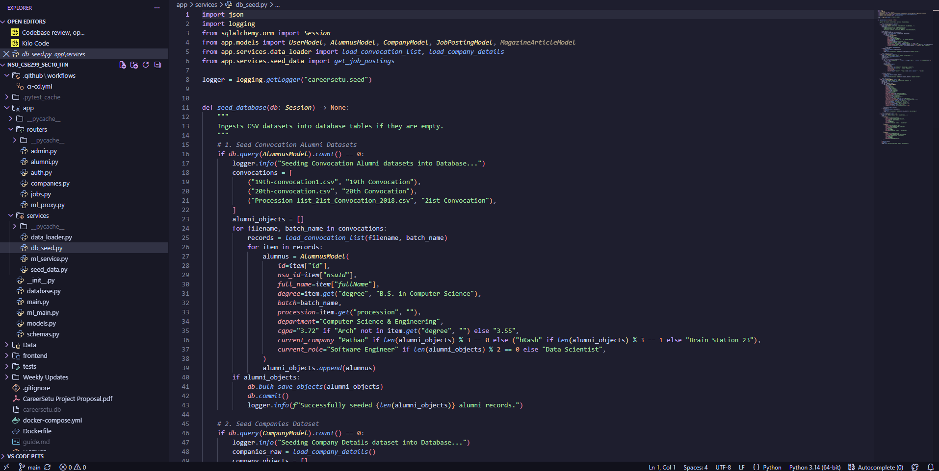
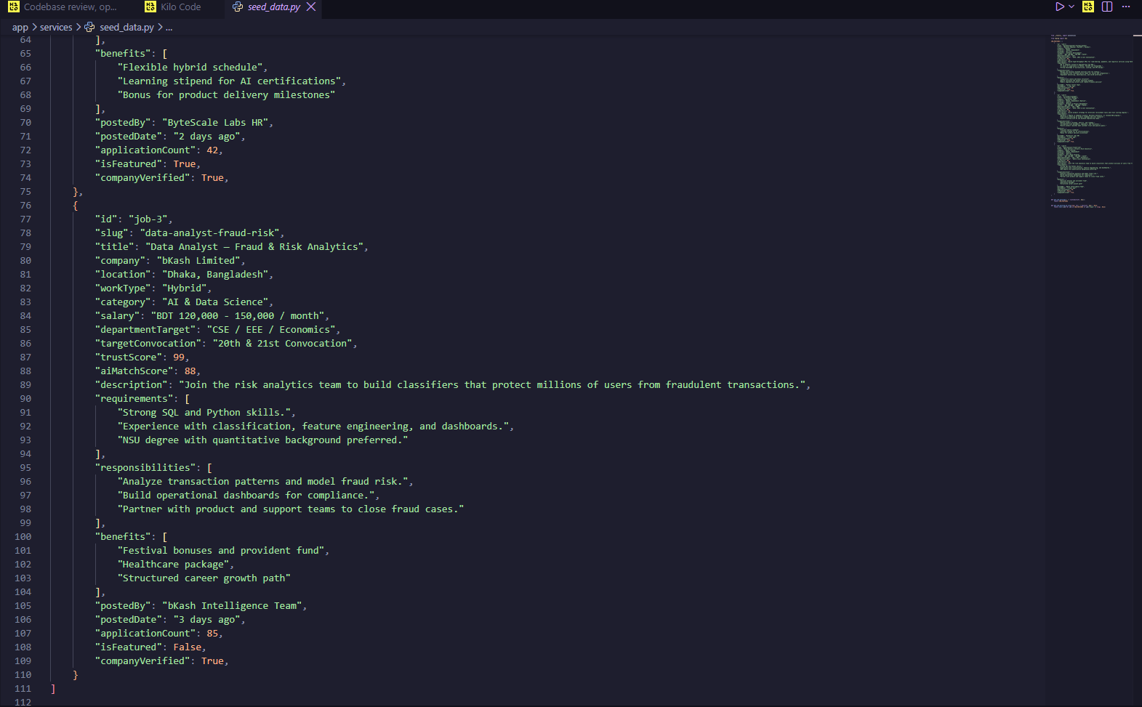
EVIDENCE · 1 OF 5
Relational Database Layer — Models & Seeding
github.com/DarkMonarch1/NSU_CSE299_SEC10_ITN — app/services/db_seed.py & seed_data.py
SQLAlchemy ORM defines 7 tables incl. AlumnusModel, CompanyModel, JobPostingModel, CVAnalysisModel and JobTrustAuditModel
db_seed.py auto-ingests all three convocation CSVs (19th/20th/21st) into AlumnusModel rows only when the table is empty
seed_data.py pre-loads verified job postings — like bKash's Data Analyst, Fraud & Risk Analytics role — with trust & AI-match scores baked in
CareerSetu | Sprint 5 Weekly Review | CSE299 Sec.10
05 / 14

Slide 6
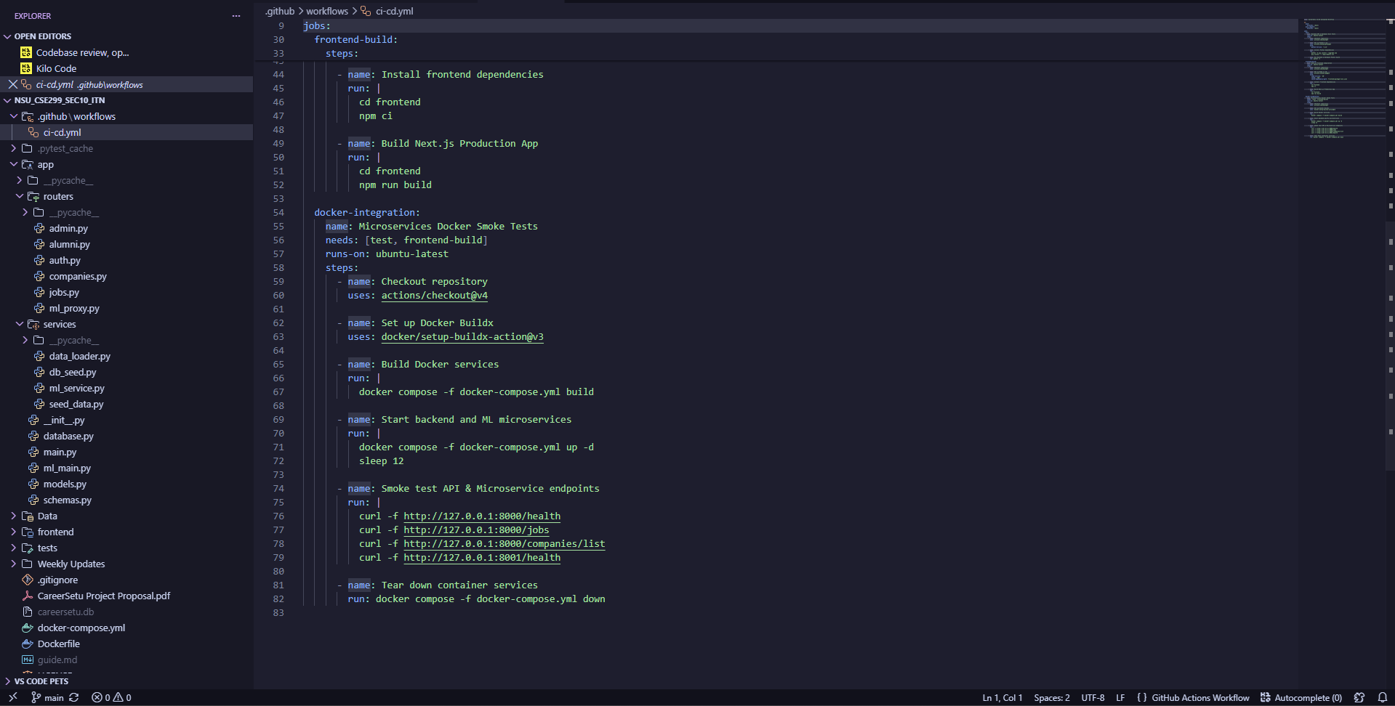
EVIDENCE · 2 OF 5
CI/CD Workflow — Docker Smoke Test Definition
NSU_CSE299_SEC10_ITN/.github/workflows/ci-cd.yml
The docker-integration job builds and starts both the backend and ML microservice via Docker Compose before testing anything
A “Smoke test API & Microservice endpoints” step curls /health, /jobs and /companies/list on the backend (port 8000)
...then curls port 8001's /health for the ML microservice — the exact line this sprint's failure traces back to
Container services are torn down afterward regardless of outcome, keeping runners clean
CareerSetu | Sprint 5 Weekly Review | CSE299 Sec.10
06 / 14

Slide 7
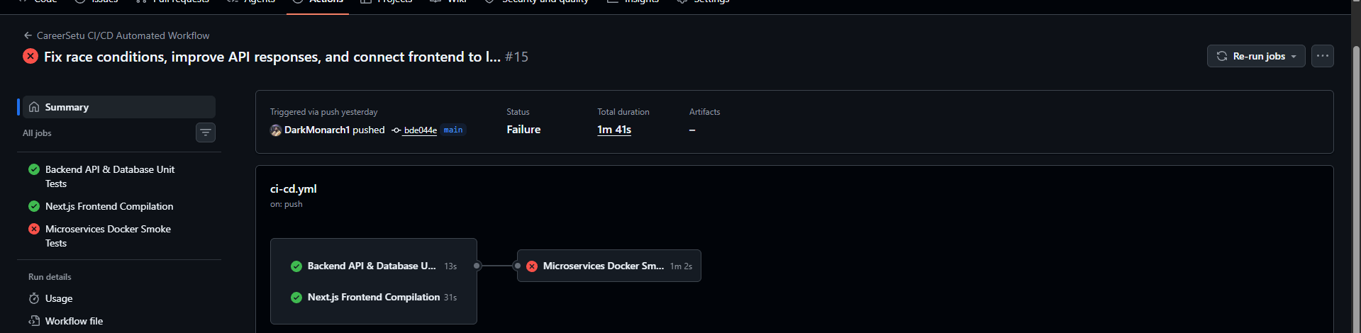
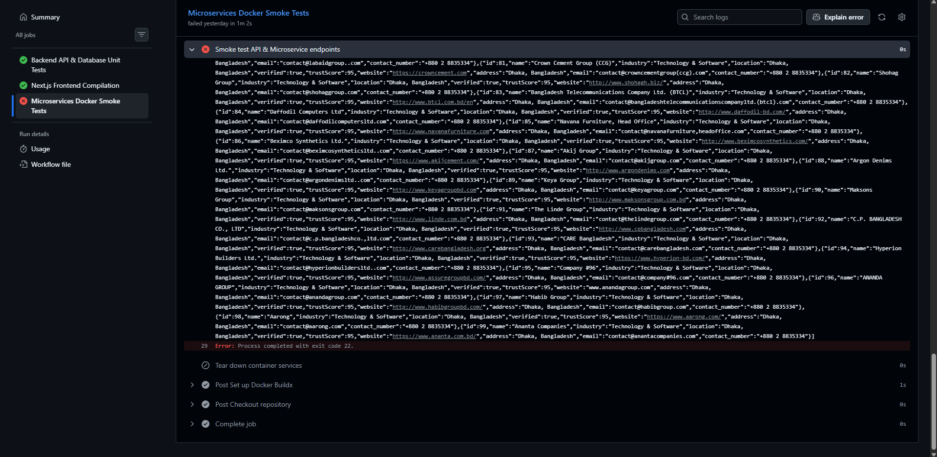
EVIDENCE · 3 OF 5
Pipeline Breaks — Smoke Test Failure
GitHub Actions — NSU_CSE299_SEC10_ITN — Run #15
Push #15 (“Fix race conditions, improve API responses...”) passes both the backend unit tests (13s) and the frontend build (31s)
The Microservices Docker Smoke Tests job fails after 1m 2s — “Process completed with exit code 22”
Exit code 22 is curl's own -f failure code: one of the four smoke-test requests came back with an HTTP error
The failure surfaces the moment the workflow reaches the ML microservice's untested health route
CareerSetu | Sprint 5 Weekly Review | CSE299 Sec.10
07 / 14

Slide 8
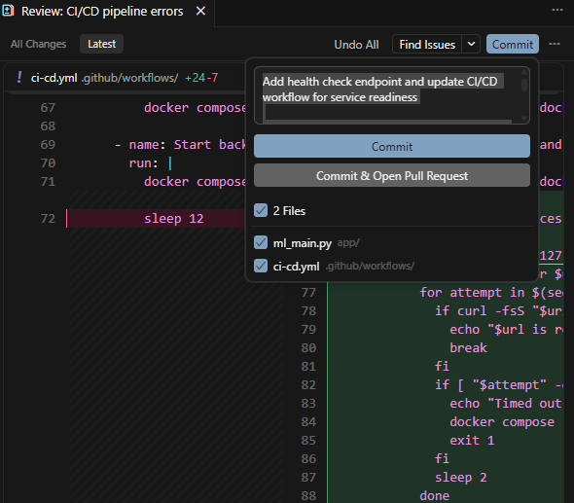
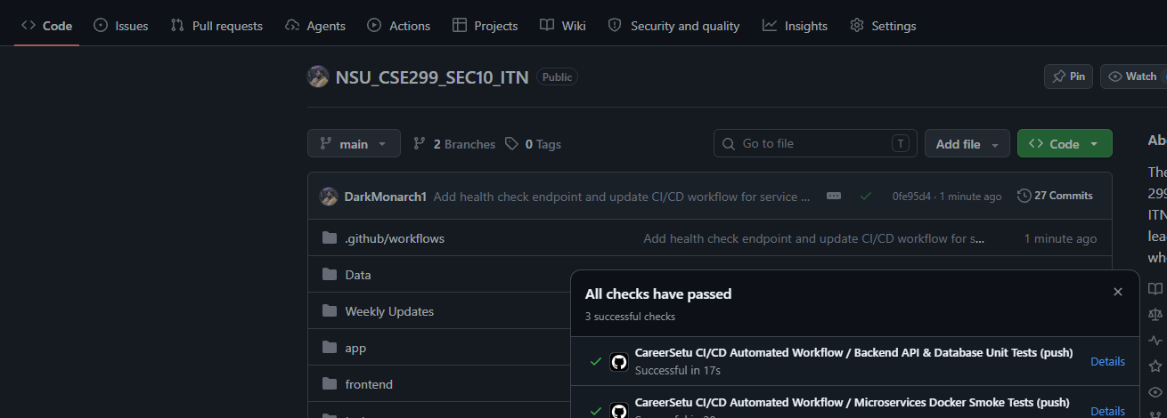
EVIDENCE · 4 OF 5
The Fix Lands — Health Endpoint & Retry Loop
GitHub — NSU_CSE299_SEC10_ITN — commit 0fe95d4
Commit: Add health check endpoint & update CI/CD workflow
Next run on main — 3/3 checks passing
Root cause: ml_main.py never exposed a /health route, so curl -f against port 8001 returned 404 and exit code 22
The fix adds that endpoint and replaces the workflow's blind sleep 12 with a retry loop that polls each service until it responds
Commit “Add health check endpoint and update CI/CD workflow for service readiness” ships both changes together
Result: all 3 jobs — backend tests, frontend build, Docker smoke tests — pass green on the next run
CareerSetu | Sprint 5 Weekly Review | CSE299 Sec.10
08 / 14

Slide 9
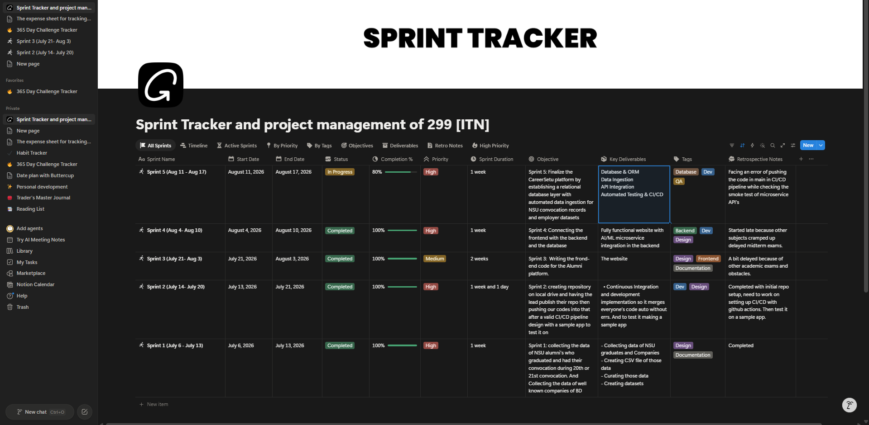
EVIDENCE · 5 OF 5
Sprint Tracking in Notion
Notion — Sprint Tracker (299 [ITN])
Sprint 5 (Aug 11 – 17) sits at 80% In Progress, High priority, across a 1-week window — tagged Database, Dev and QA
Key deliverables tie directly to what shipped: Database & ORM, Data Ingestion, API Integration, Automated Testing & CI/CD
Retrospective notes stay just as candid as Sprint 4's: “facing an error of pushing the code in main... while checking the smoke test of microservice APIs”
Four straight sprints logged honestly in the same tracker — this one included, mid-fix
CareerSetu | Sprint 5 Weekly Review | CSE299 Sec.10
09 / 14

Slide 10
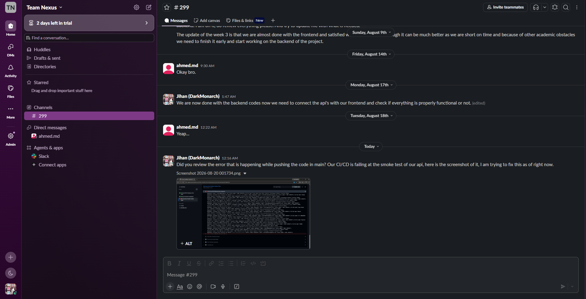
COMMUNICATION REVIEW
Team Communication — Slack
Slack — Team Nexus / #299
The #299 thread stays just as short as Sprint 4's — a handful of check-ins, most real work landing in commits
Aug 14: Tahsin's “Okay bro” is the only reply for several days
Aug 17–18: Jihan reports the backend done and pivots to frontend wiring; Tahsin's “Yeap...” is the last word before the failure
Today: Jihan shares the CI/CD failure screenshot directly in-channel and flags that he's debugging it live
CareerSetu | Sprint 5 Weekly Review | CSE299 Sec.10
10 / 14

Slide 11
RISK MANAGEMENT
Risks & Issues
Risk
Likelihood
Impact
Mitigation
Sprint 5's own CI/CD pipeline broke mid-sprint — Docker smoke tests failing on push #15
Add the missing ML health endpoint and a readiness retry loop instead of a blind sleep — shipped same day
High
High
Notion still shows 80% while the pipeline fix has already landed and passed
Update the tracker to reflect SPRINT5.md once frontend wiring is confirmed fully live
Medium
Low
Only the lead (DarkMonarch1) has authored the database, API-wiring and CI/CD-fix commits
Carry forward from Sprint 3/4 — assign Tahsin concrete, committed tickets, not just review
High
Medium
Academic exams have now delayed or complicated four sprints in a row
Keep Sprint 5/6 marked High priority with daily Slack syncs until frontend wiring is verified end-to-end
High
Medium
One new risk this sprint — the pipeline broke on the very infrastructure meant to catch integration bugs, and caught one within a day.
CareerSetu | Sprint 5 Weekly Review | CSE299 Sec.10
11 / 14

Slide 12
RETROSPECTIVE
What Went Well, What We're Improving
✓
WENT WELL
!
TO IMPROVE
Relational database layer fully wired: 7 SQLAlchemy models seeded from real CSVs, not mocks
The initial push to main still broke the pipeline — health checks should exist before endpoints ship, not caught after by CI
CI/CD's Docker smoke test did exactly its job — caught a real missing-health-endpoint bug before it reached users
Tahsin's involvement stayed at acknowledgment level (“Okay bro”, “Yeap...”) rather than authored commits
The fix (health endpoint + retry loop) shipped same day, verified with 3/3 checks green
Notion tracker (80%) hasn't caught up with the shipped fix and green pipeline yet
Frontend-backend wiring is now underway across jobs, alumni, cv-grooming, employer and admin pages
80%
Sprint 5 completion (per tracker) — database, seeding and CI/CD fix shipped and verified; full frontend live-wiring confirmation carries into Sprint 6.
CareerSetu | Sprint 5 Weekly Review | CSE299 Sec.10
12 / 14

Slide 13
LOOKING AHEAD · SPRINT 6
Next Sprint: Verifying Live Data End-to-End
SPRINT 6 OBJECTIVE
Confirm every frontend page is reading real data from the live API — not cached or mock fallbacks — close out remaining auth & admin-moderation work, and bring the Notion tracker back in line with what's shipped.
DELIVERABLE & META
Key Deliverable:
⚠
Every page — alumni, jobs, companies, CV grooming, employer, admin — verified end-to-end against the live database, with the CI/CD pipeline staying green through it.
Sprint 5 delivered its full documented scope but broke its own pipeline doing it. Sprint 6 inherits both the verification work and the discipline of catching these bugs before they reach main.
Contributors:
Jihanur Rahman Ratul & Tahsin Ahmed Sufol
Priority:
High
Tags:
Integration / QA
CareerSetu | Sprint 5 Weekly Review | CSE299 Sec.10
13 / 14

Slide 14
🤝
Thank You
We welcome your feedback, ITN Sir
SCORING RUBRIC & OPEN QUESTIONS
Does treating this sprint's CI/CD failure-and-fix as a legitimate deliverable — not just a setback — match how you'd want integration bugs like this documented going forward?
CSE299 · North South University · Section 10 · Team Nexus

